Slide 1
Location Privacy Protection Using Dummy Locations and Routes
Wen-Chen Hu and Naima Kaabouch
School of Electrical Engineering and Computer Science
University of North Dakota
Grand Forks, ND 58202-7165
wenchen@cs.und.edu and naima.kaabouch@und.edu

Slide 2
Outline
Introduction
LBS (location-based service)
The proposed research
The problems with dummy locations/routes
The proposed methods
Experiment results
Summary

Slide 3
Worldwide PC and Cell Phone Sales
Year | Numbers of Units Shipped (Million)
 | Feature phones | Smartphones | PCs and servers | Tablet PCs
2009 | 1,055 | 166 | 306 | 1
2010 | 1,609 | 286 | 346 | 17
2011 | 1,323 | 486 | 365 | 73
2012 | 1,048 | 698 | 352 | 128
2013 | 838 | 968 | 296 (PCs only) | 195
2014 | 634 | 1,245 | 313 (PCs only) | 227
2015 | 486 | 1,424 | 290 (PCs only) | 196
2016 | 396 | 1,495 | 270 (PCs only) | 157
2017 | ⸺ | 1,537 | 263 (PCs only) | 164
2018 | ⸺ | 1,555 | 259 (PCs only) | 174

Slide 4
LBS (Location-Based Service) Forecasts
The worldwide market of LBS applications is expected to grow from USD 11.36 billion in 2015 to USD 54.95 billion by 2020, at a CAGR of 37.1%.
The LBSs are one of the top three consumer mobile applications and services in 2012, and the most popular LBSs would be navigation, location search, friend finder/social networks, and advertising.
GNSS (Global Navigation Satellite System) market is expected to thrive with new technological applications and to grow at a CAGR (Compound Annual Growth Rate) of 9.4 percent during 2014-2020.

Slide 5
The Proposed Research
This research discusses various problems of dummy locations and proposes robust methods to preserve LBS users’ privacy. In addition to LBSs, this research emphasizes continuous LBSs, which require users to send their location data to the service providers continuously. Therefore, instead of dummy locations, dummy routes are created and sent to the providers. This research proposes genuinely dummy routes, so service providers are not able to find the true routes among all routes.

Slide 6
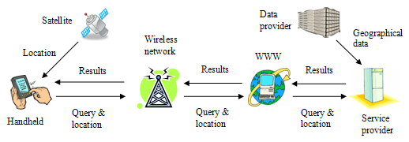
Location-Based Services (LBSs)
mobile handheld devices, • positioning system,
mobile and wireless networks, • service providers, and
geographical data providers.

Slide 7
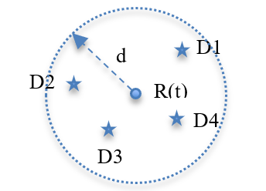
Dummy Location Generation
Random Locations within a Distance (LBS)
Random locations are randomly generated within a distance d from the true location. For example, the figure shows four dummy locations (D) generated based on the true location (R) at the time t.

Slide 8
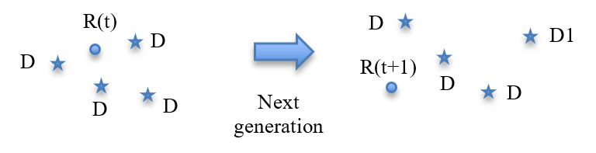
Dummy Location Generation (Cont.)
Random Locations (LBS)
Dummy locations are generated randomly. For example, the figure shows the true location (R) and four dummy locations (D) generated randomly at the times t and t+1.

Slide 9
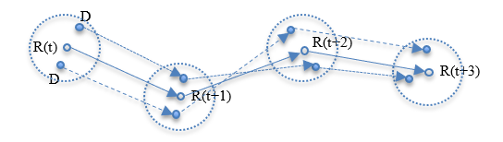
Dummy Location Generation (Cont.)
Random Locations within a Distance (Continuous LBS)
  The two endpoints of a dummy path are random locations within a distance d from the true locations. For example, the figure shows the dummy paths created by using random locations within a distance from the true location R at different times (t).

Slide 10
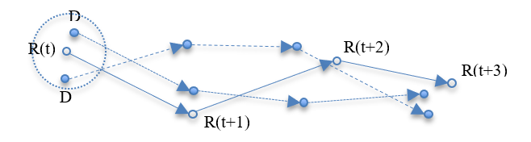
Dummy Location Generation (Cont.)
Random Locations (Continuous LBS)
  The dummy paths are generated randomly. For example, the figure shows the dummy routes ceated by using random locations (D).

Slide 11
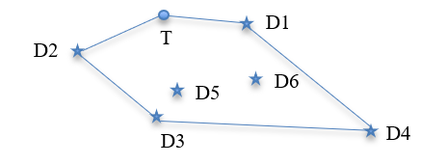
The Proposed Method
Random Locations on or within a Polygon (LBS)
  This research uses a concave polygon, which covers all true and dummy locations and of which the area is less than or equal to an area a. For example, the figure shows the six dummy locations (D) generated based on the true location (T).

Slide 12
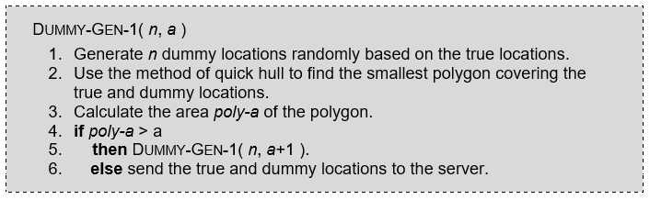
The Proposed Method (Cont.)
Random Locations on or within a Polygon (LBS) (Cont.)
  Below is the algorithm of the proposed dummy locations generation.

Slide 13
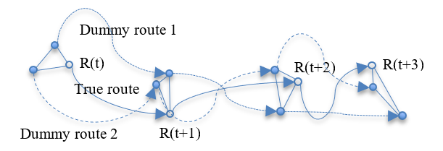
The Proposed Method (Cont.)
Random Locations in a Smallest Polygon (Continuous LBS)
  The two endpoints of a dummy path are random locations on a polygon within an area a and the path is generated by using Google Direction API. For example, the figure shows the dummy locations created by using a polygon within an area, where R is a true location and t is the time.

Slide 14
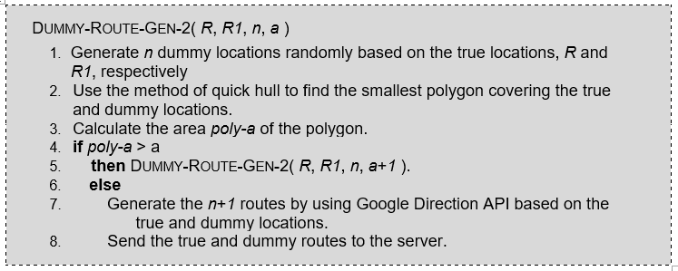
The Proposed Method (Cont.)
Random Locations in a Smallest Polygon (Continuous LBS) (Cont.)
  Below is the algorithm of the proposed dummy routes generation using a smallest polygon.

Slide 15
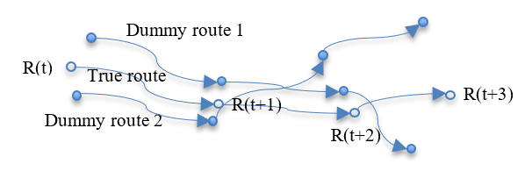
The Proposed Method (Cont.)
Random Locations (Continuous LBS)
  The dummy routes are generated randomly. For example, the figure shows the dummy routes created by using random locations.

Slide 16
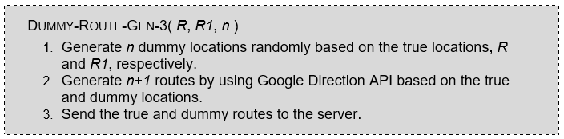
The Proposed Method (Cont.)
Random Locations (Continuous LBS) (Cont.)
  Below is the algorithm of the proposed dummy routes generation using random locations.

Slide 17
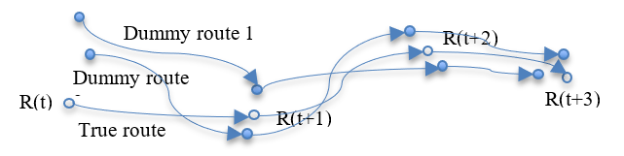
The Proposed Method (Cont.)
Random Paths within a Distance (Continuous LBS)
  The dummy paths are randomly generated within a distance d between each point of the dummy path and the true path. For example, the figure shows the dummy routes generated by using random routes within a distance.

Slide 18
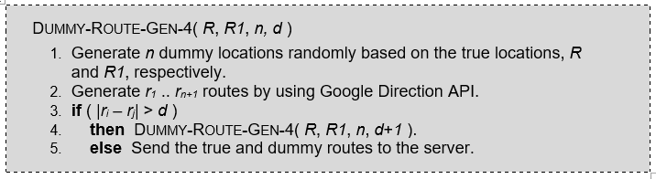
The Proposed Method (Cont.)
Random Paths within a Distance (Continuous LBS) (Cont.)
  Below is the algorithm of the proposed dummy paths generation using random locations.

Slide 19
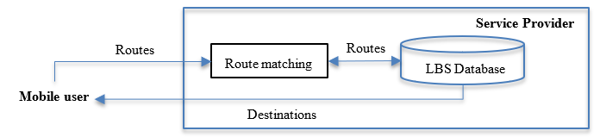
The Proposed System
The proposed service is made simple on purpose and its system structure is shown above, where a set of routes are collected and saved by the service provider before the app is put to use. When the user requests a recommendation, his/her current route and the stored routes are matched. The destinations of the matched routes are the recommended destinations.

Slide 20
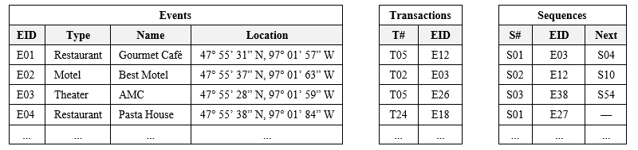
The Geographical Database
Schemas and sample values of the tables Events, Transations, and Sequences. The Events stores a small set of events. Each transaction or sequence consists of a list of events. The difference between a transaction and a sequence is the events of the former are unordered, whereas the ones of the latter are ordered.

Slide 21
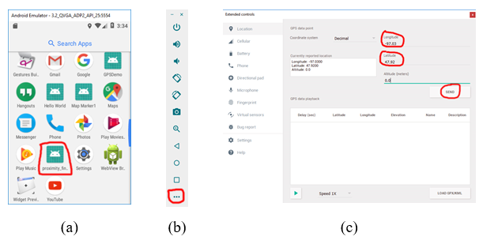
Experiment Results
(a) The proposed app shown in the Android Launcher, (b) the Control Panel, and (c) the Extended Controls

Slide 22
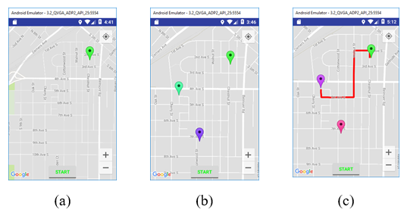
Experiment Results (Cont.)
(a) user marked, (b) two possible destinations, and (c) direction between the user and the destination

Slide 23
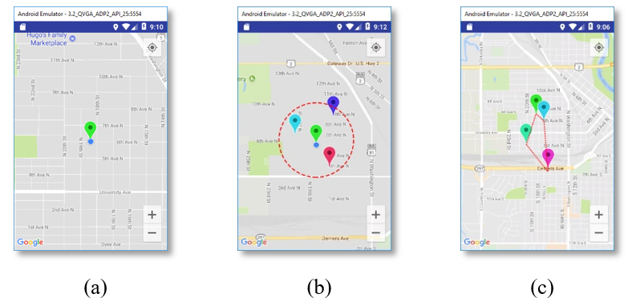
Experiment Results (Cont.)
(a) true locations marked, (b) three dummy locations within a distance, and (c) dummy location on or within a polygon

Slide 24
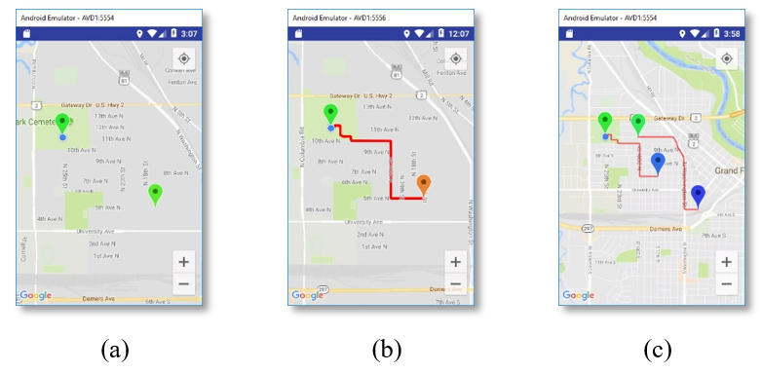
Experiment Results (Cont.)
(a) two locations marked, (b) direction drawn, and (c) dummy direction created

Slide 25
Summary
This research first shows the possible pitfalls of the method of dummy locations and routes. A robust method is then proposed to solve the problems. Preliminary experiment results show this method is simple and effective for privacy preservation of location-based services. However, actual road testing and solid proofs need to be given to prove the effectiveness and robustness of the proposed method. The ideas will be further improved or revised based on users’ feedbacks and testing data.

